Slide 1
BIKE SHARING DEMAND ANALYSIS
By – Aryan Kashyap
NextHikes IT Solutions

Slide 2
Dataset Overview
This is the bike demand dataset. We merged multiple datasets to derive this final dataset which shows patterns of customers overtime and how the weather conditions affect the rentals.
Total Rentals: 58,304 • Average Rides per Hour: 58.3 • Clear Sky dominates (64% of rides).

Slide 3
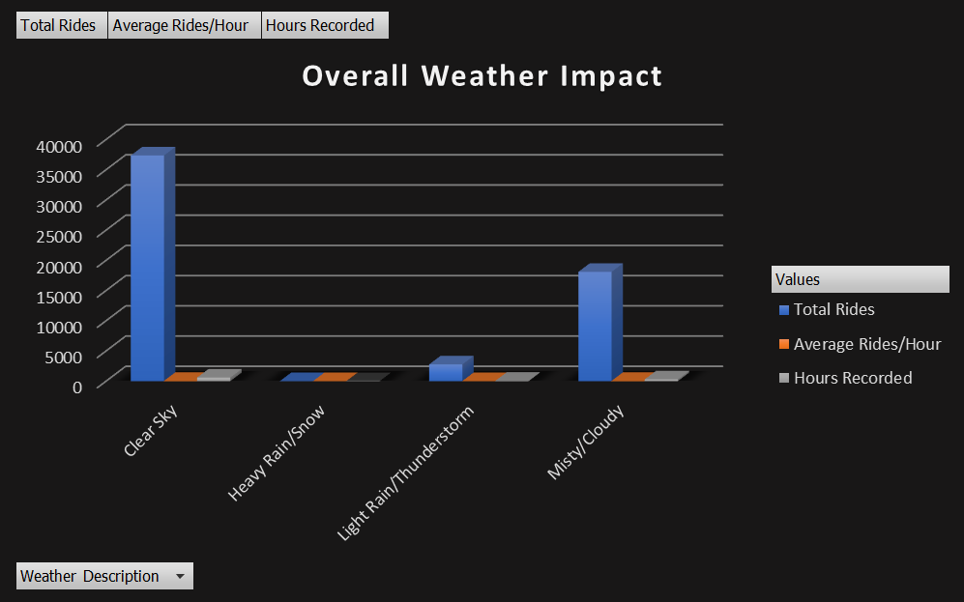
Overall Weather Impact
Demand drops when weather changes from Clear Sky to Misty/Cloudy and further slumps when it rains or snows.

Slide 4
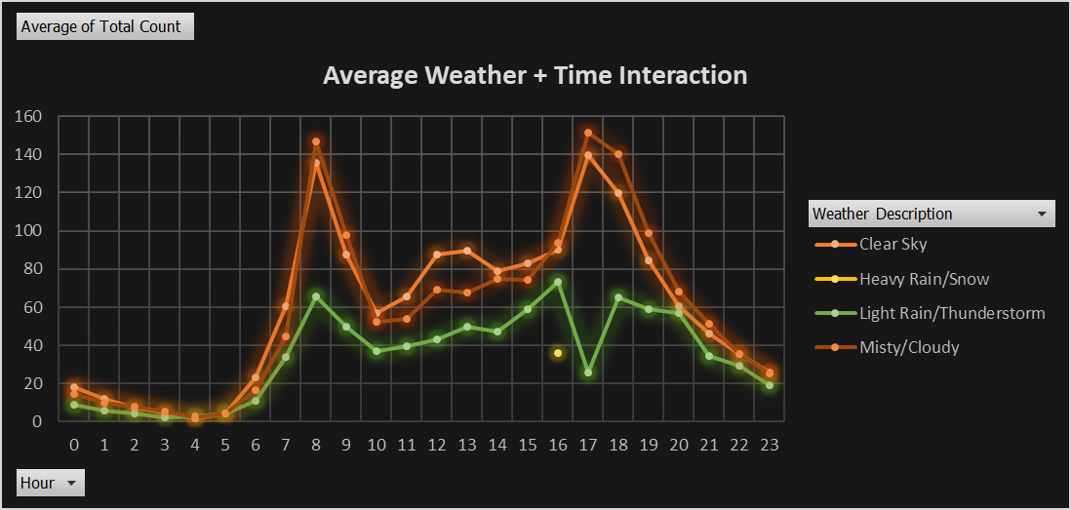
Weather + Time Interaction
Morning Rush between 8am and 9:30am is observed.
Evening Peak between 4pm to 9pm is observed.
Clear Sky draws most customers, followed by Misty/Cloudy weather.

Slide 5
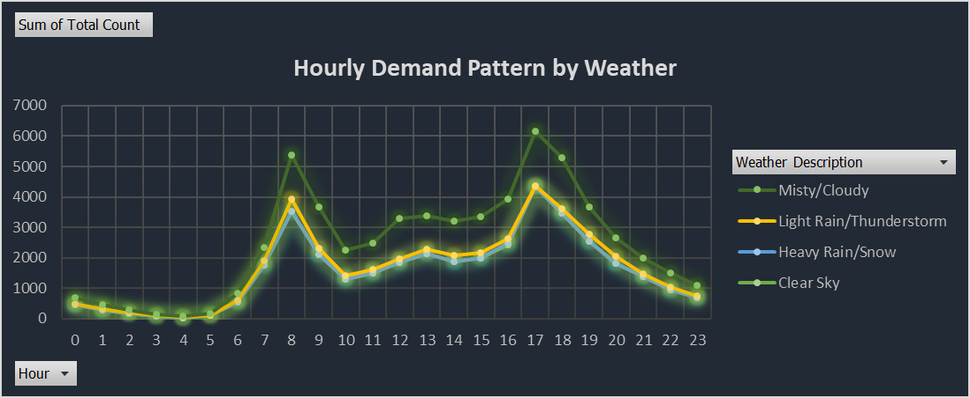
Hourly Demand Pattern by Weather
Morning Rush between 8am and 9:30am is observed.
Evening Peak between 4pm to 9pm is observed.
Clear Sky draws most customers, followed by Misty/Cloudy weather.

Slide 6
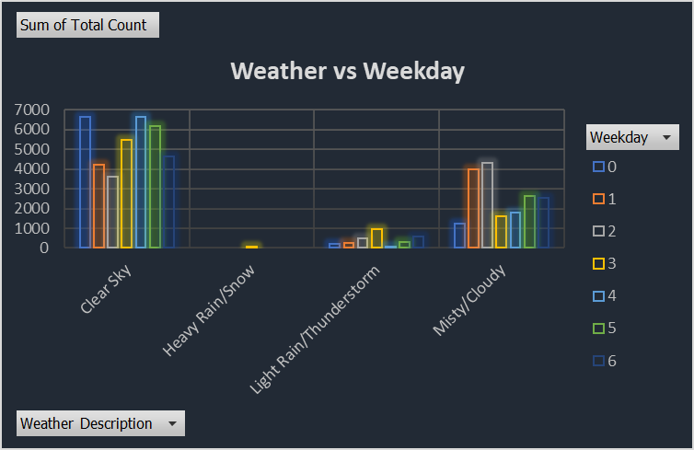
Weather vs Weekday
Wednesdays (denoted by 4), Thursdays (denoted by 5) and Saturdays (denoted by 0) witness most customers in Clear weather conditions.
Misty/Cloudy weather brings most of the customers on Sundays (denoted by 1) & Mondays (denoted by 2).
Rain and Snow hurts customer count the most.

Slide 7
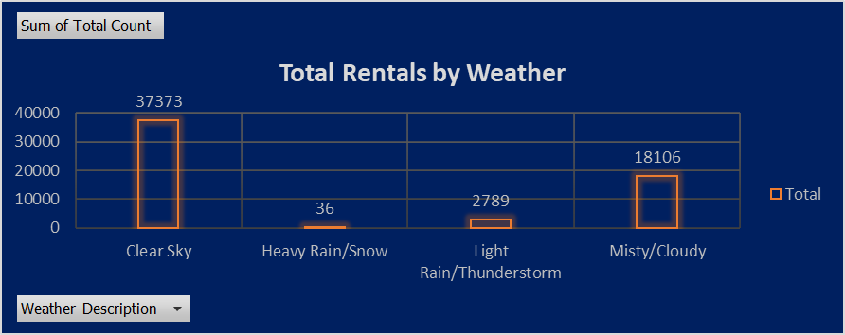
Total Rentals by Weather
Again, the dominance of clear weather condition is evident in bringing in the customers.
Misty/Cloudy weather also manages to draw in customers, but not as significantly.
Rainy weather and Snow condition heavily hit the customer count.

Slide 8
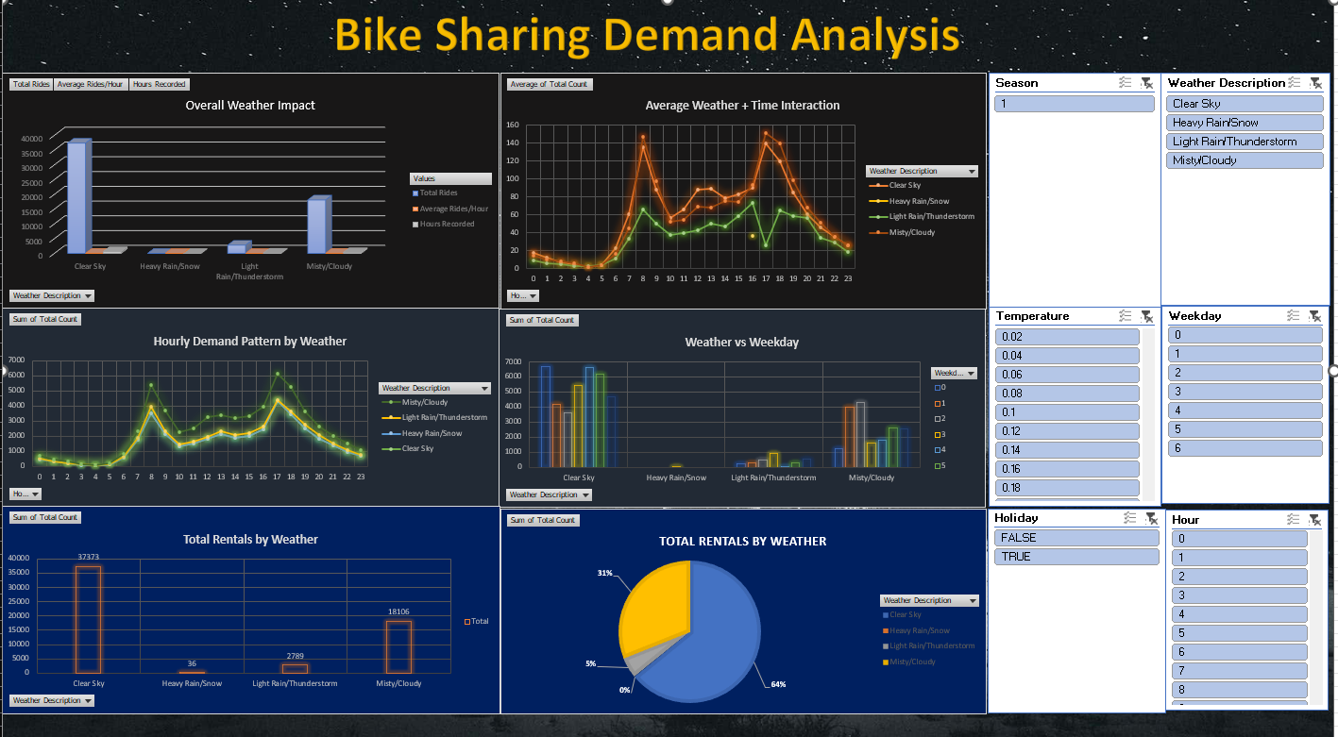
Dashboard

Slide 9
Key Insights & Recommendations
Insights:
Weather is a key driver with respect to rentals, Clear Sky days sees approx. 2x times the rides than Rainy Days.
Morning (8am) & Evening (5-6pm) Peaks are reliable.
Misty/Cloudy conditions still perform decent.
Bad Weather conditions hit rentals hardest.
Recommendations:
Increase bike availability & promotions on clear days.
Offer Rain Discounts to draw customers even on bad weather days.
Focused marketing on weekday commuting hours.
Weather based dynamic pricing should be considered.

Slide 10
THANK YOU.

